Slide 1

INFO-6001
Information Security
Gihan Shamike Liyanage
1142109
Lab Assignment 04 - Netbus

Slide 2
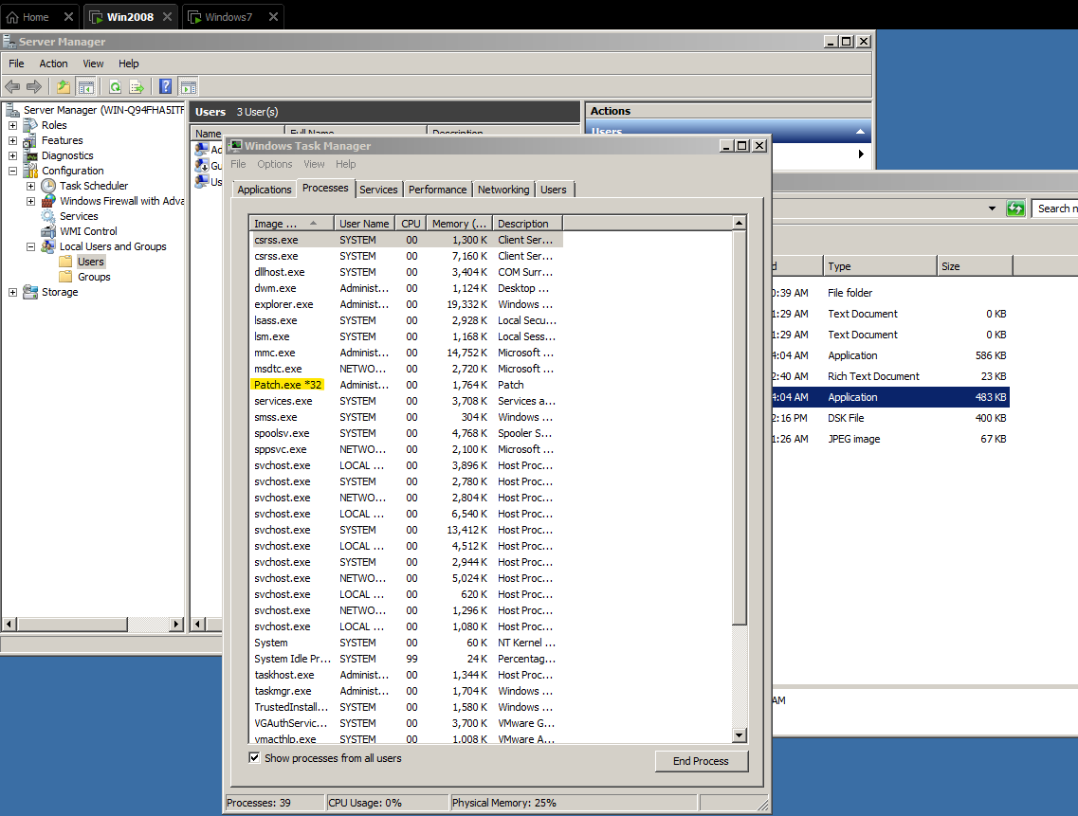
Screen Shot 1
1

Slide 3
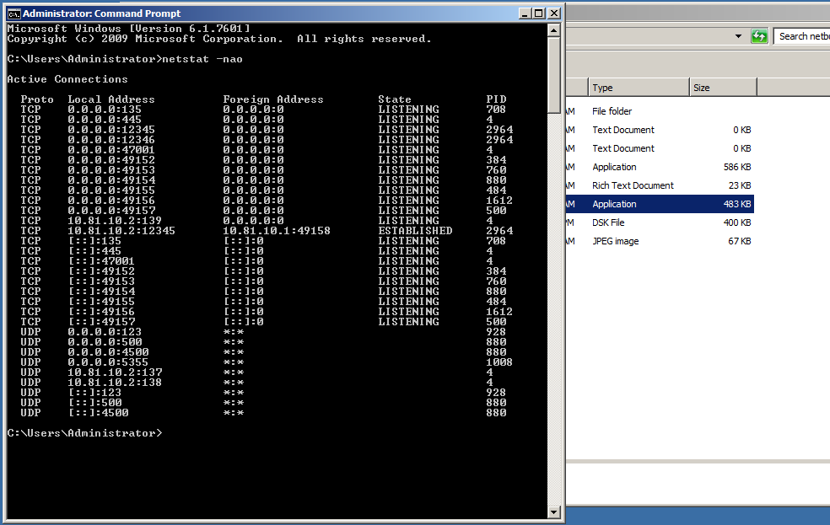
Screen Shot 2
2

Slide 4
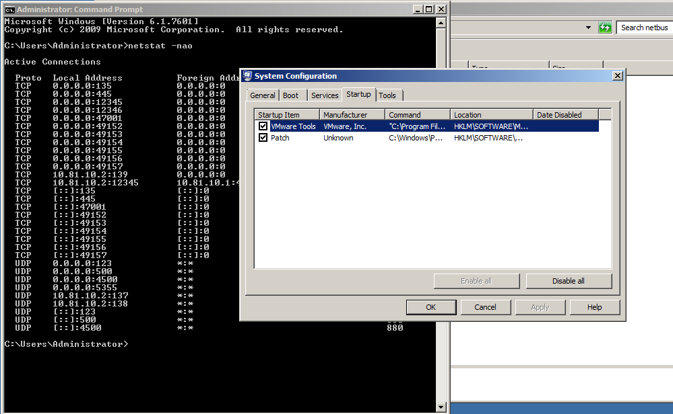
Screen Shot 3
3

Slide 5
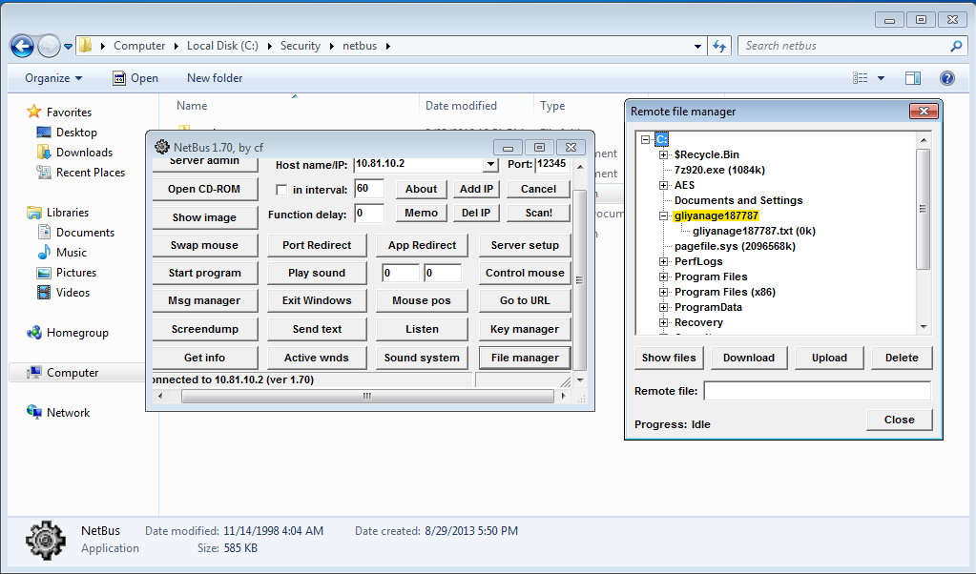
Screen Shot 4
4

Slide 6
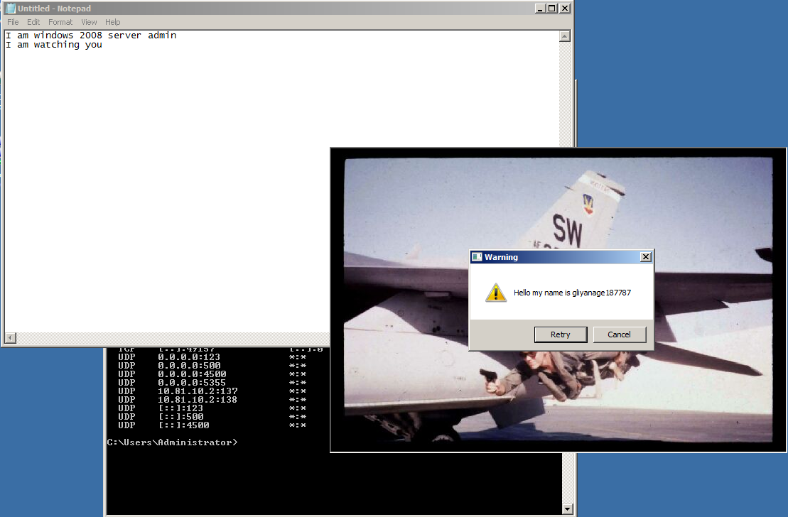
Screen Shot 5
5

Slide 7
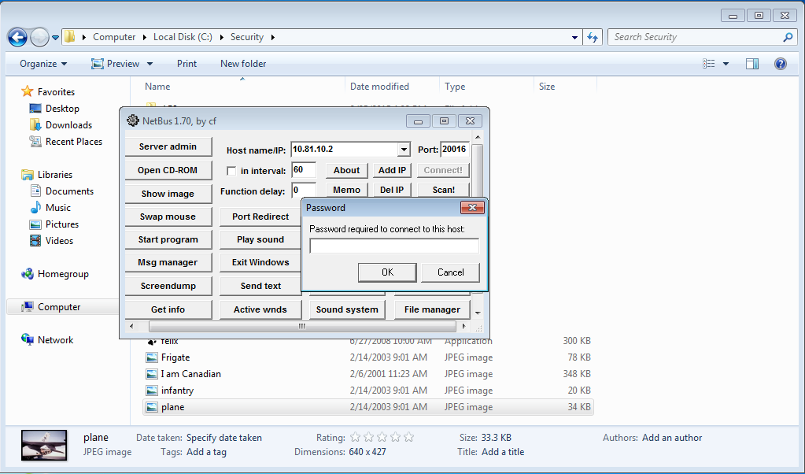
Screen Shot 6
6

Slide 8
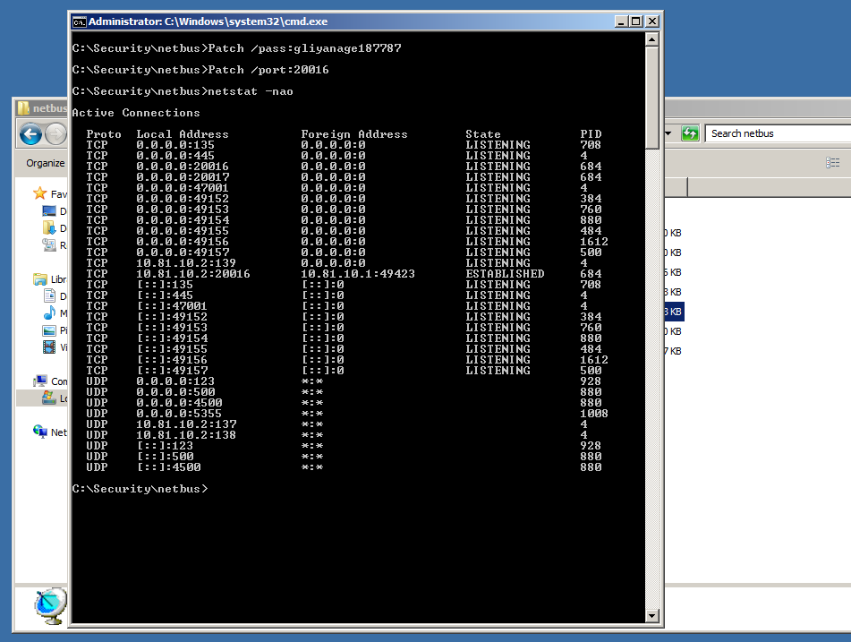
Screen Shot 7
7

Slide 9
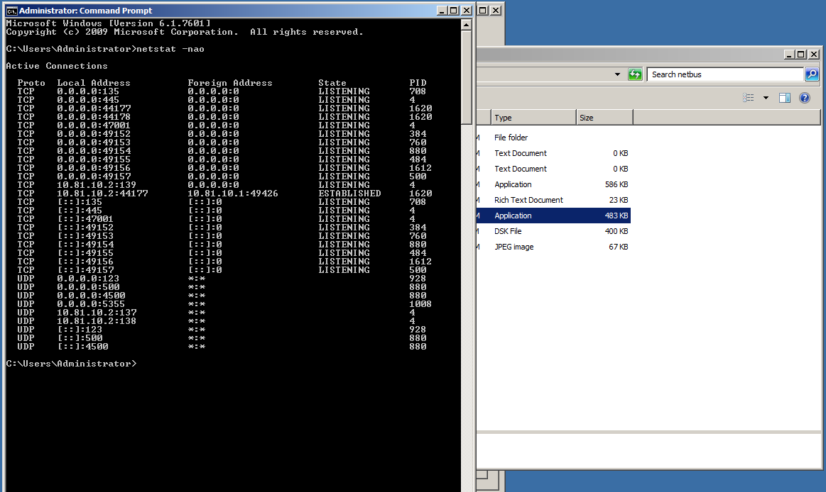
Screen Shot 8
8

Slide 10
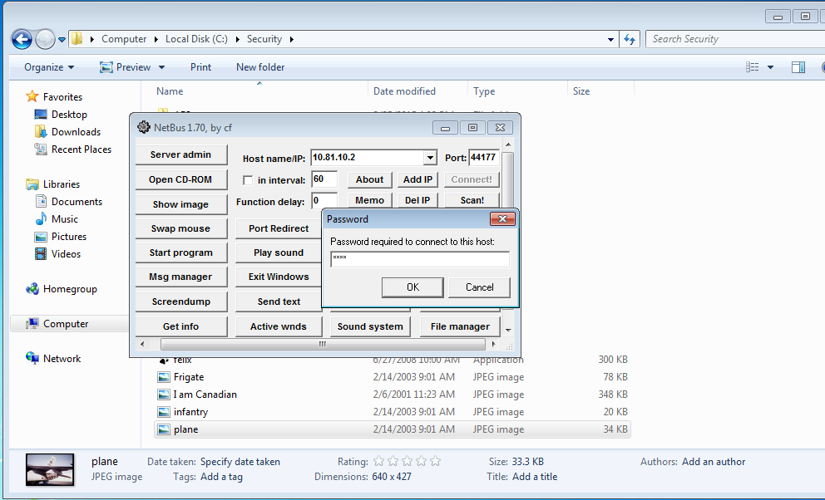
Screen Shot 9
9

Slide 11
Answers to Question 10
Here are some of the most useful features of NetBus for a hacker:
Remote Access: With NetBus, a hacker can secretly take control of a victim's computer from a distance. This implies that a hacker can view every file and application on the victim's PC and track their online behavior.
Keylogger: The keylogger function inbuilt in NetBus enables a hacker to record every keystroke made on the victim's computer. This can be used to steal private data, including credit card details, passwords, and other critical information.
File Manager: The file manager feature in NetBus enables hackers to browse, download, and upload files from the victim's computer. This implies that a hacker has the ability to erase crucial files, implant malware, and steal key papers.
Remote Shutdown: The remote shutdown function in NetBus enables a hacker to turn off the victim's PC. This may be done intentionally to cause harm or mask the hacker's trail.
These functions make available a security risk since they make it possible for hackers to access a victim's computer without authorization, steal confidential data, and even harm the victim's system. A common method for distributing malware, stealing data, and surveillance is NetBus. To guard against malware infestations and prevent unauthorized access, it's critical to keep your system updated with the most recent security patches and software upgrades.

